Slide 1
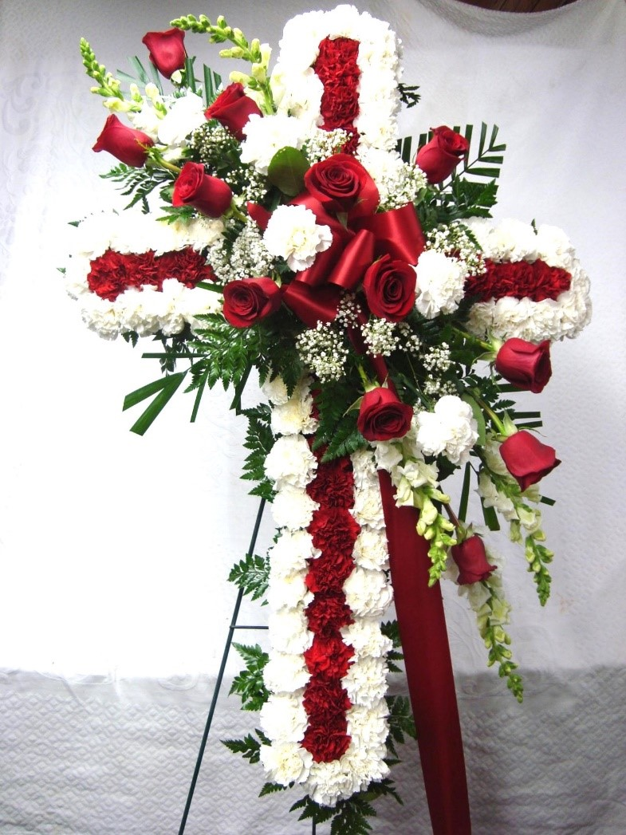
FAIRMONT HEIGHTS HIGH SCHOOL MEMORIAL SERVICE
2024

Slide 2
HONORINGOUR FALLEN HORNETS

Slide 3
Dedicated to our 1st Principal G. JAMES GHOLSON & Our 1st Memorial Service Program Creator ALLEN GRIMES

Slide 4
FACULTY WHO BUZZED AWAY

Slide 5
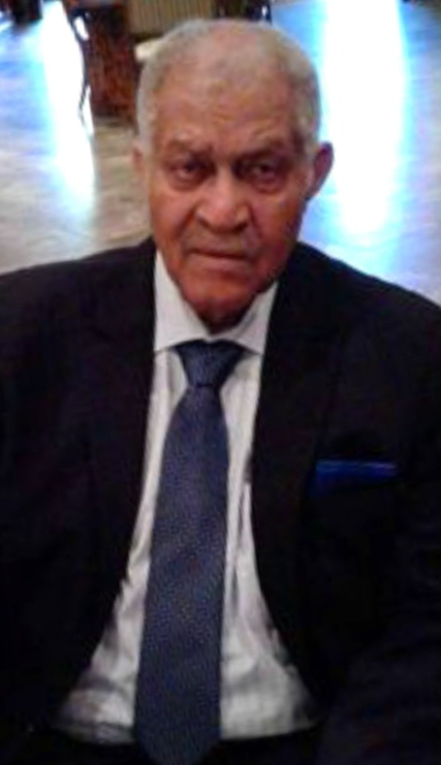
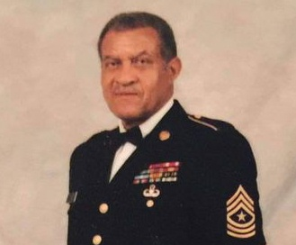
John McGee – Faculty

Slide 6
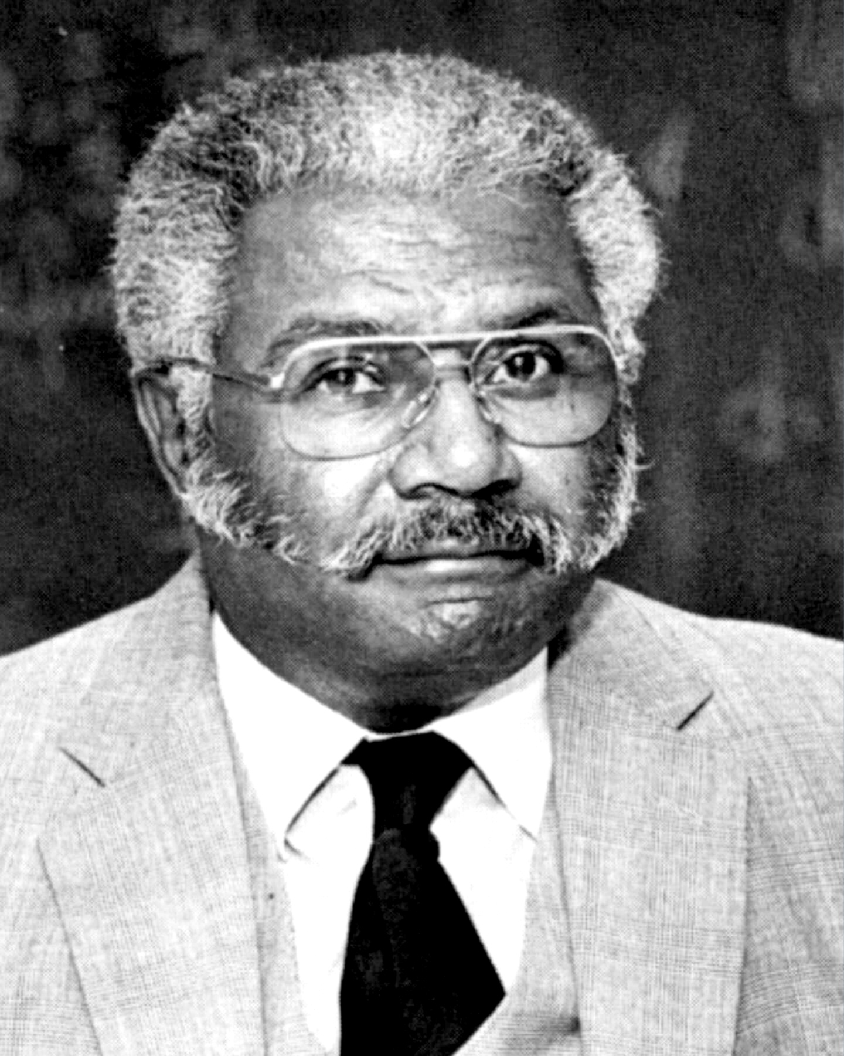
Joseph E. Pratt, Sr. – Faculty

Slide 7
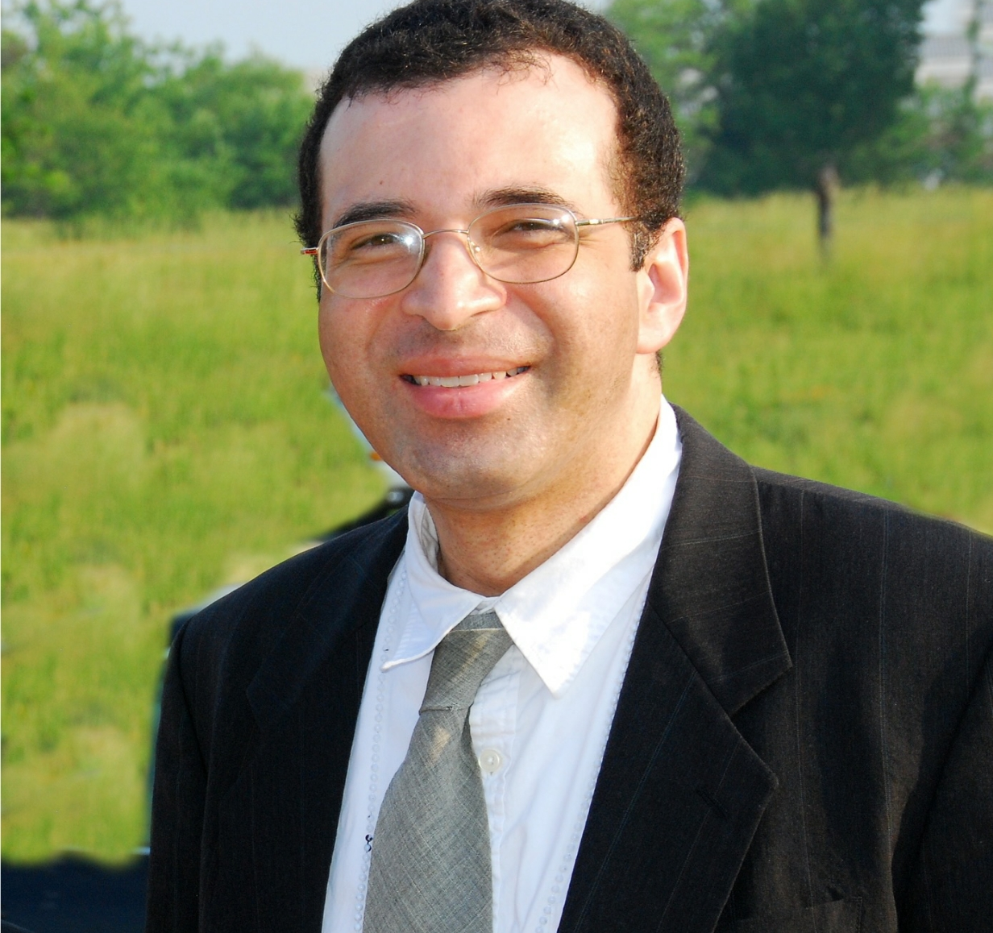
Vincent Shipp - Faculty

Slide 8
HORNETS WHO BUZZED AWAY

Slide 9
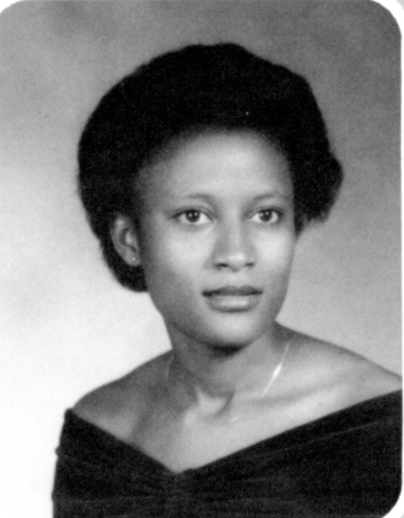
Annet Susan Chawu Class of ‘83

Slide 10
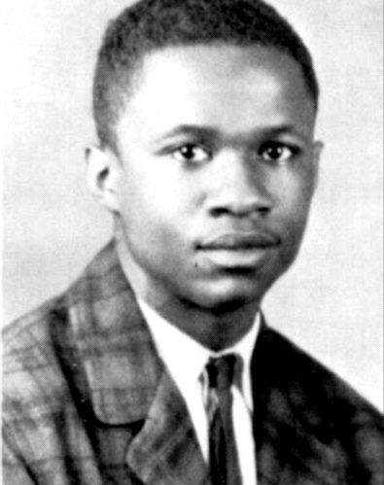
Antonio L. Abney Class of ‘63

Slide 11
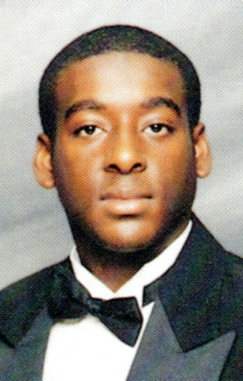
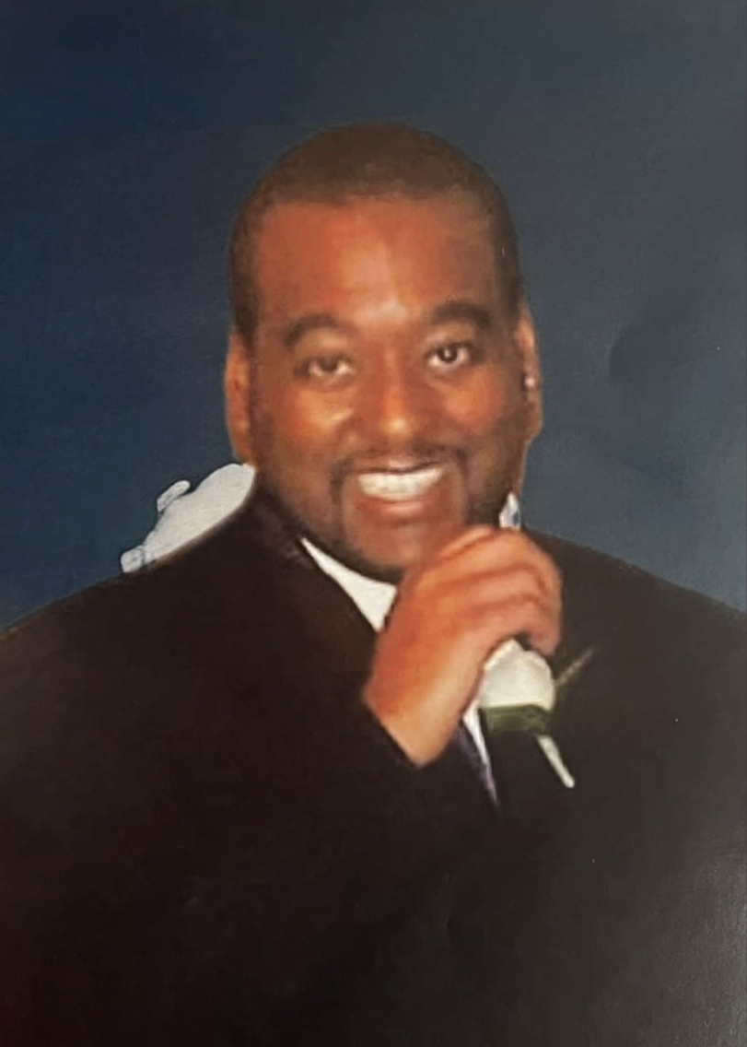
Anthony Raymond Robbins, Jr. Class of ‘97

Slide 12
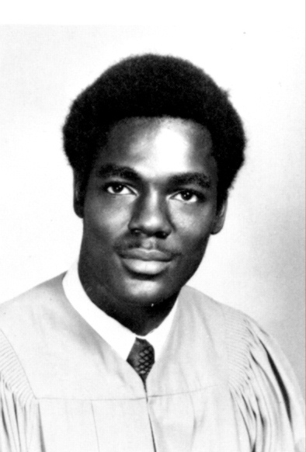
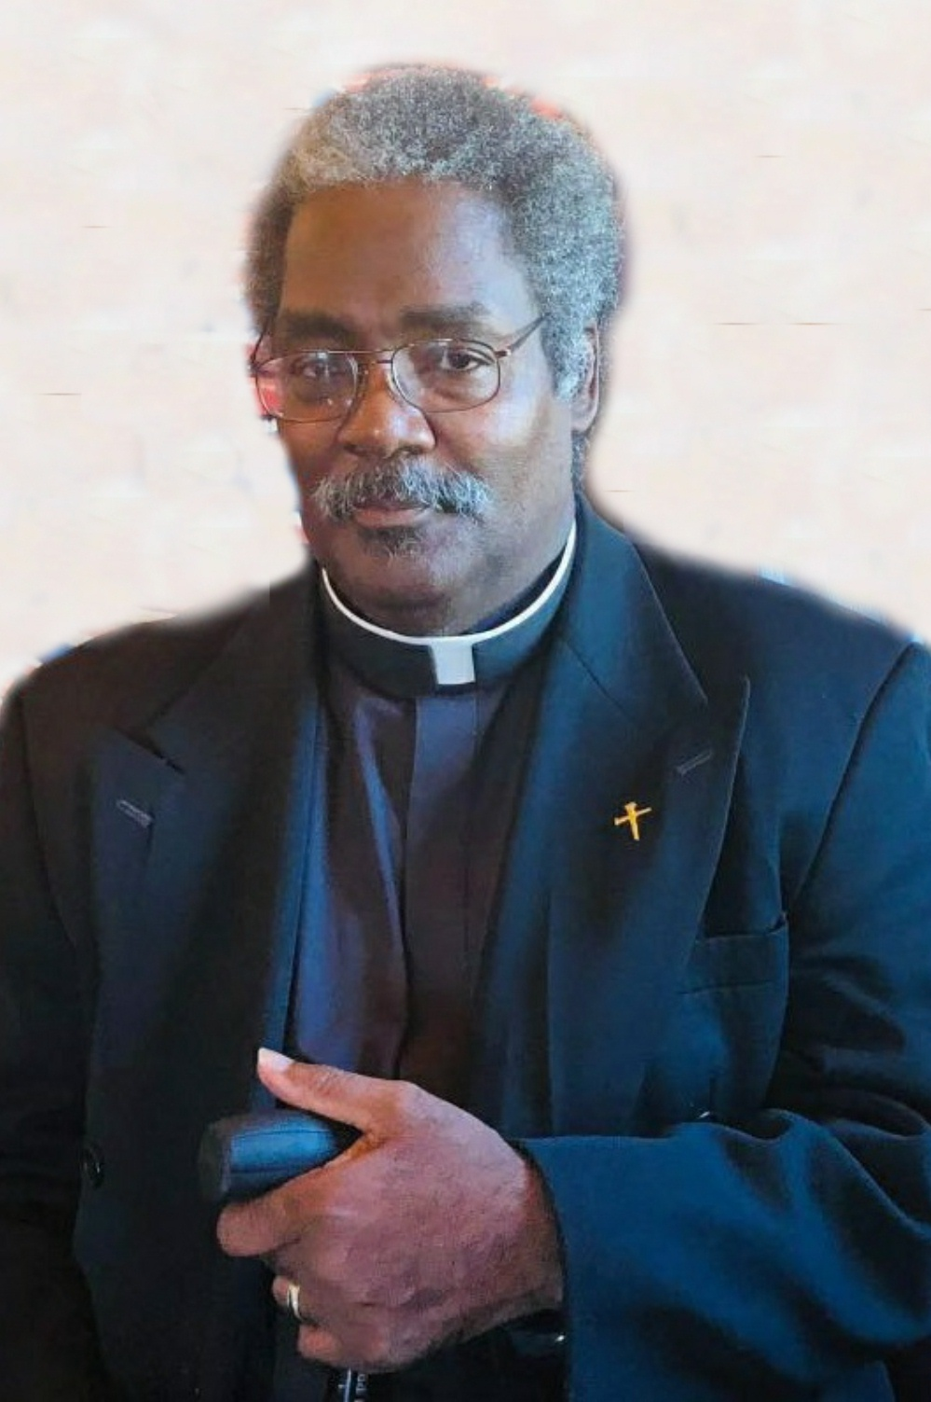
Arthur Maurice Green Class of ‘71

Slide 13
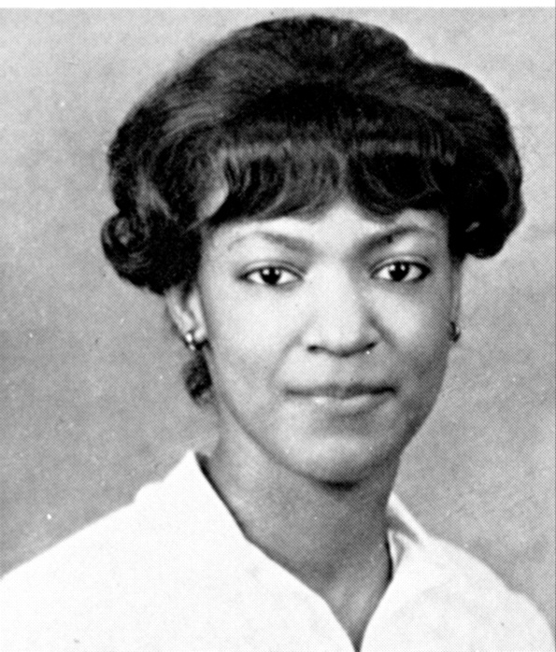
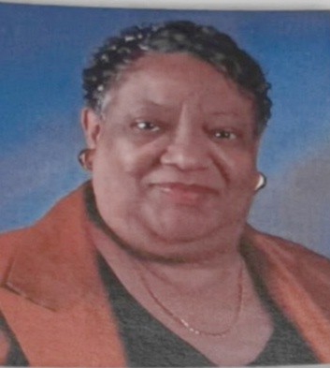
Barbara Calhoun Gales Class of ‘64

Slide 14
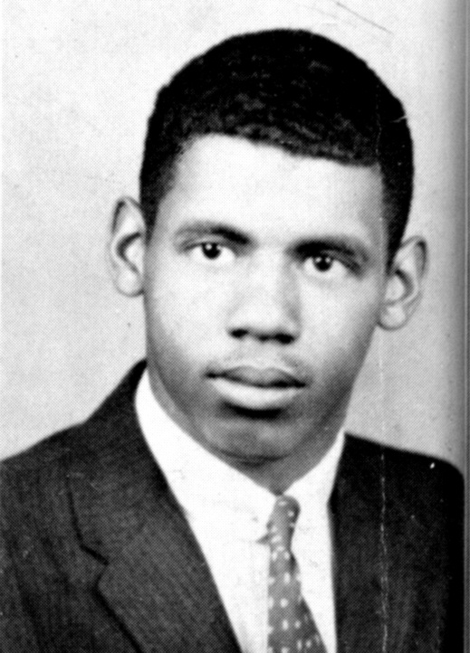
Basil S. Chittams Class of ‘60

Slide 15
Brenda Regina Willams Robinson

Slide 16
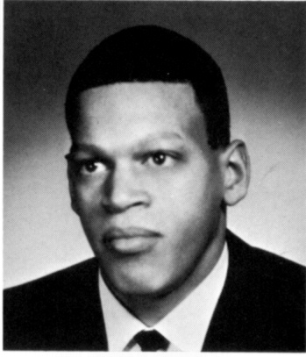
Carl Wellman Class of ‘66

Slide 17
Catherine Latney Class of ‘65

Slide 18
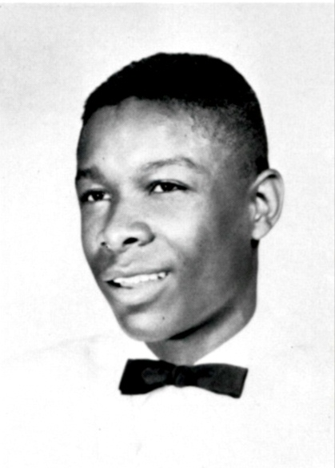
Charles Edward Markham, Jr. Class of ’67

Slide 19
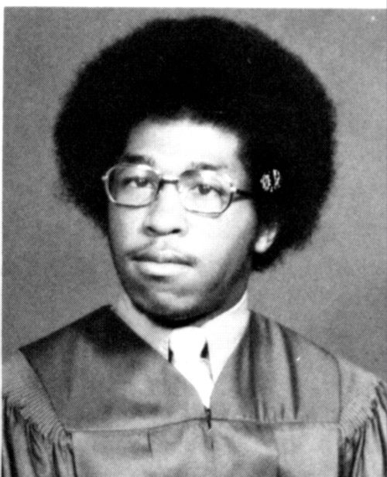
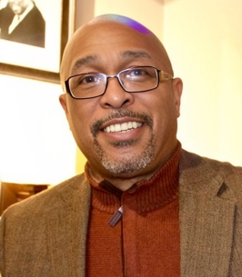
Clarence Ellsworth Franklin, Jr. Class of ‘75

Slide 20
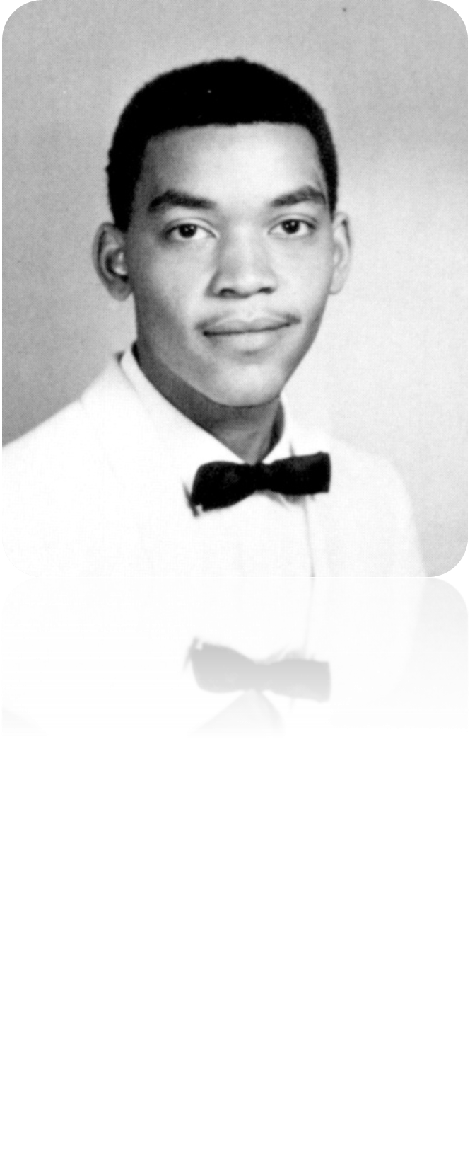
Clarence H. Wells, Jr. Class of ‘70

Slide 21
Cleo Thomas Class of ‘75

Slide 22
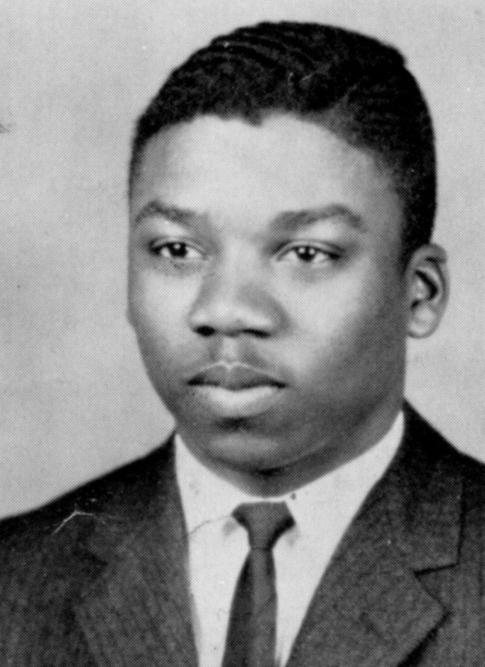
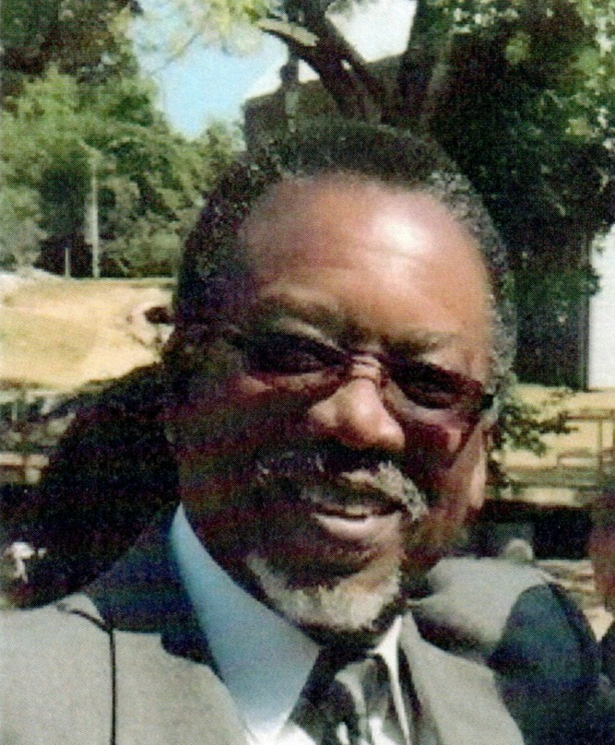
Clyde Edward Boykins Class of ‘60

Slide 23
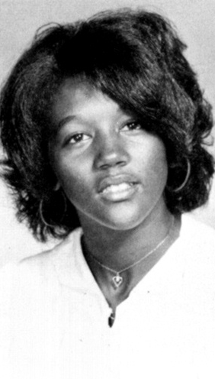
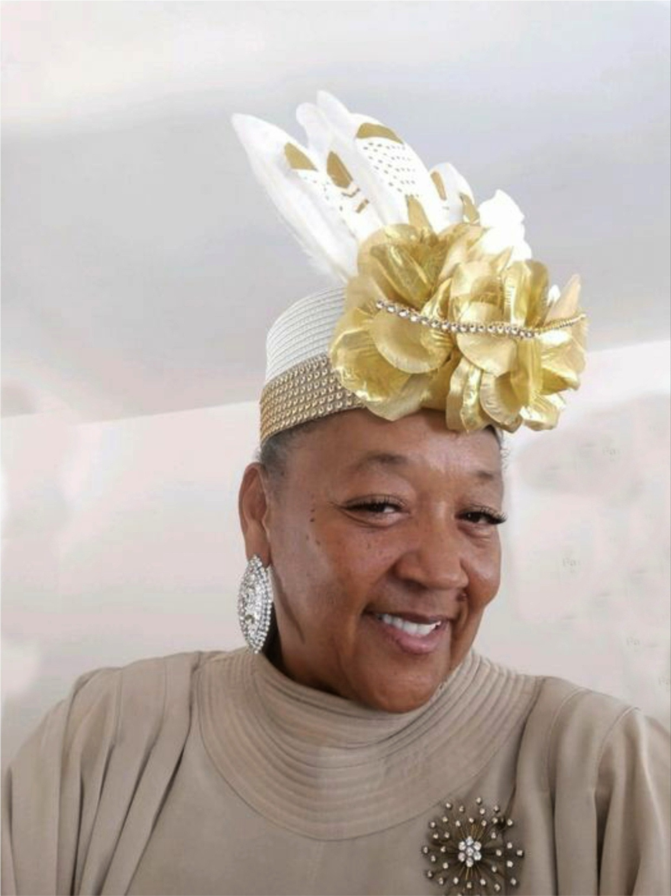
Desiree Rustin DeLoach Class of ‘73

Slide 24
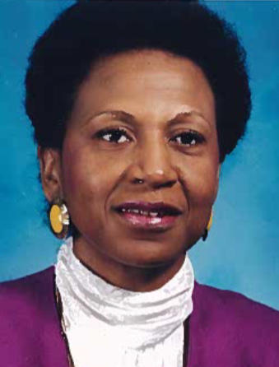
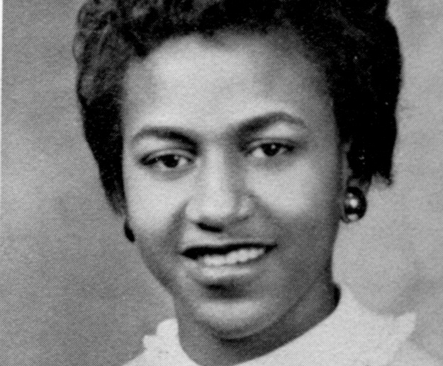
Diane Wilson-Bragg Class of ‘57

Slide 25
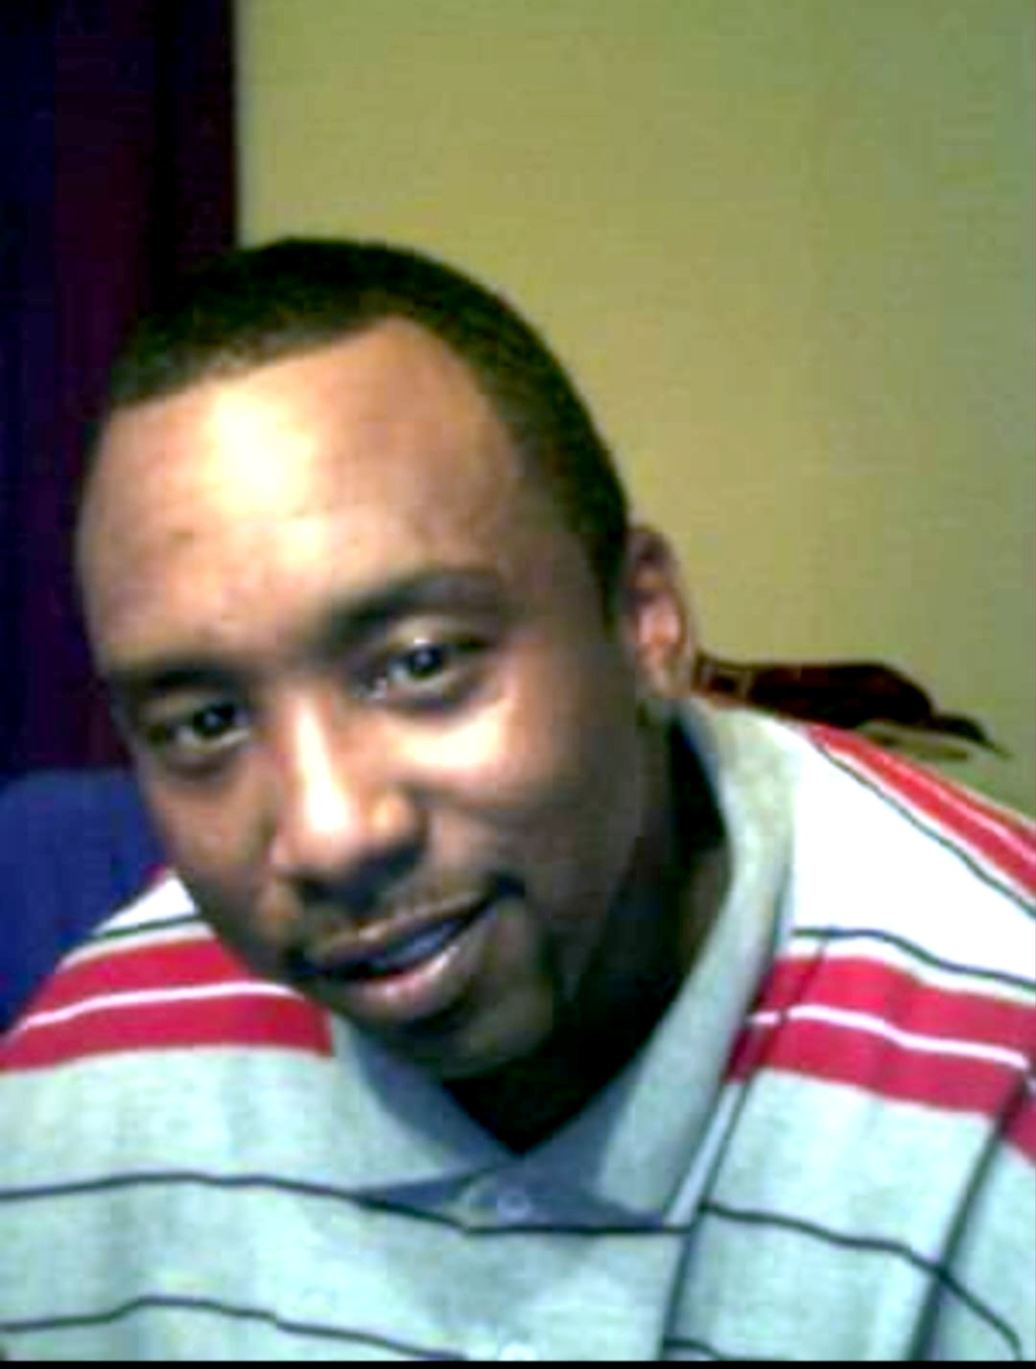
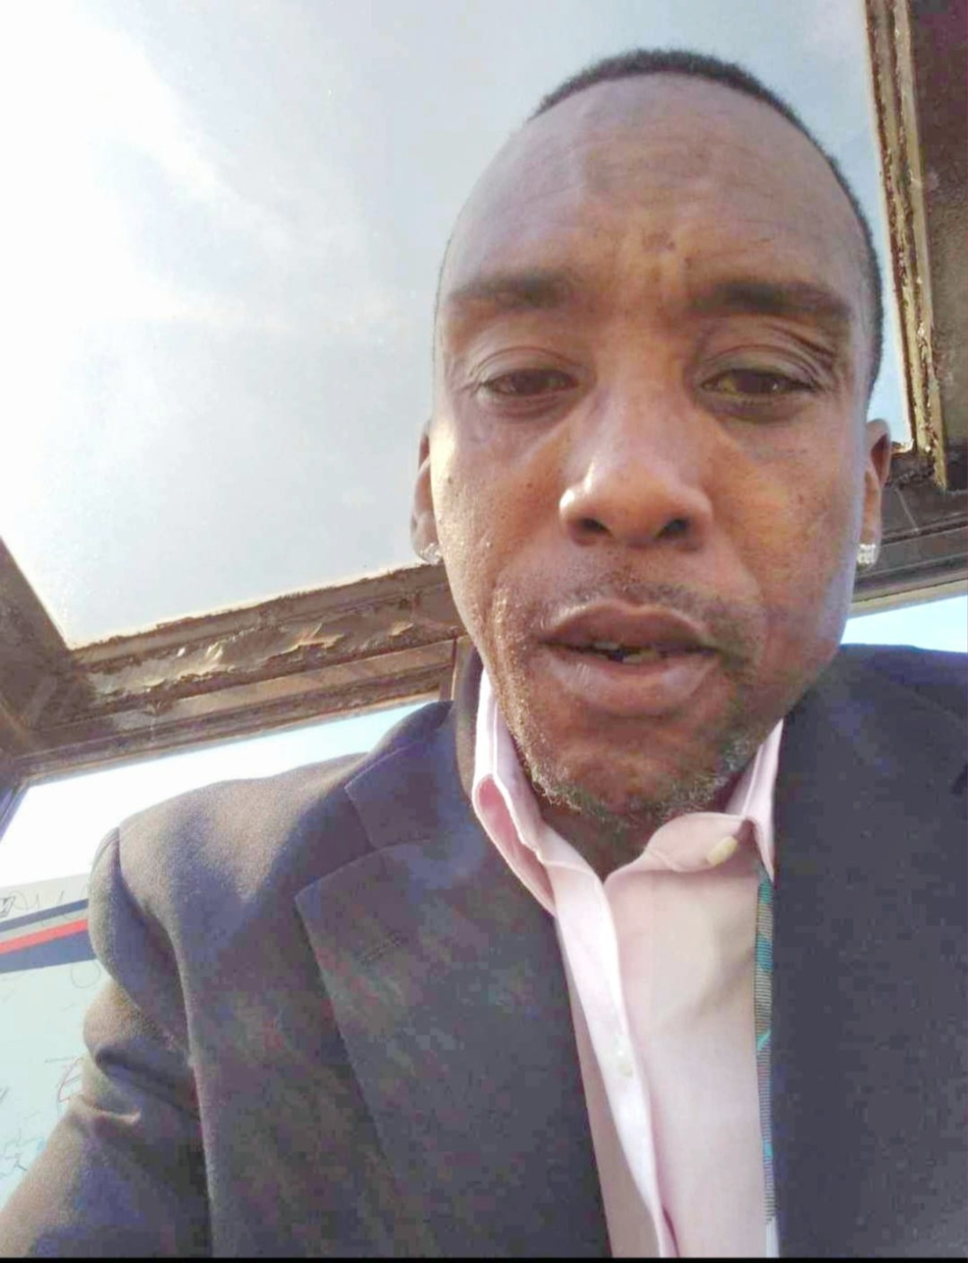
Dionne Tibbs Class of ‘88

Slide 26
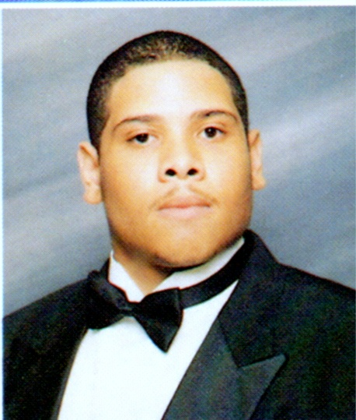
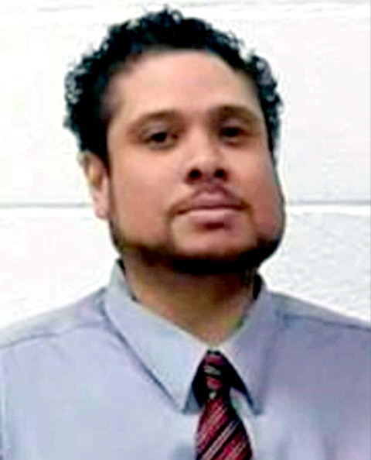
Donald Eric Gallion Class of ‘97

Slide 27
Donald Lee Stewart Class of ‘65

Slide 28
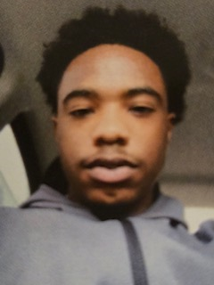
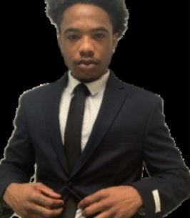
Duane Anthony Smallwood
Class of 2014

Slide 29
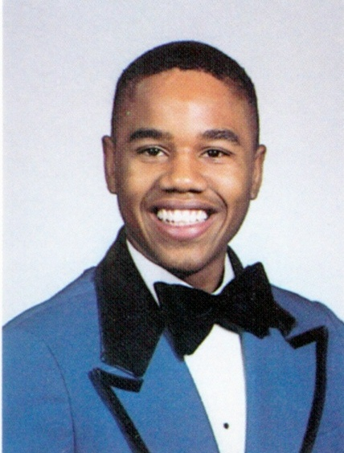
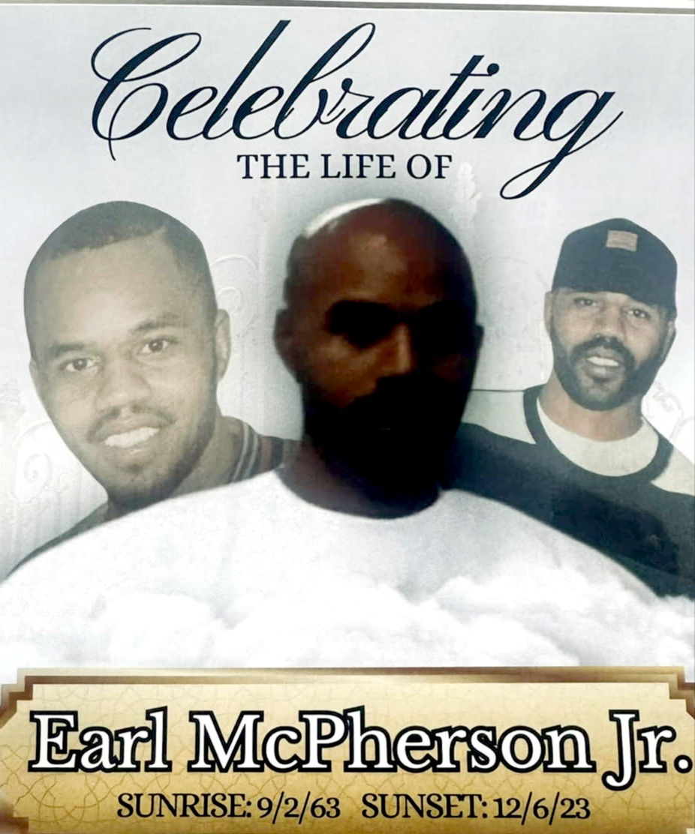
Earl McPherson, Jr. Class of ‘81

Slide 30
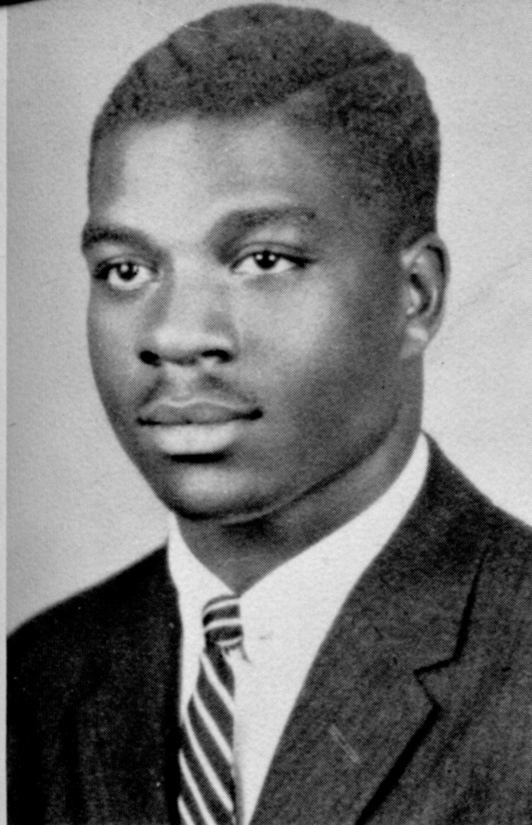
Edward N. Franklin “Hoppy” Class of ‘58

Slide 31
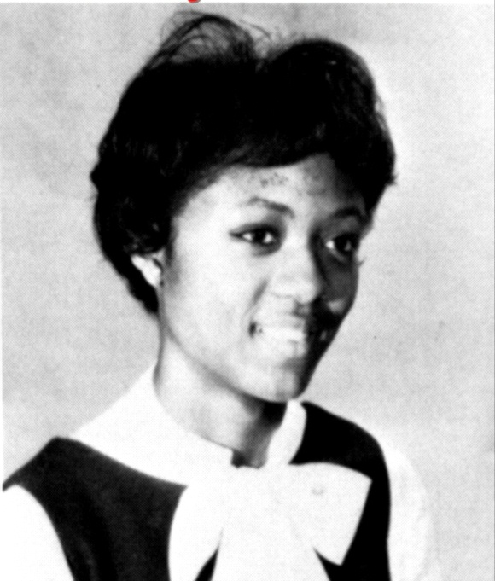
Ella Lorraine Boykins Martin Class of ‘65

Slide 32
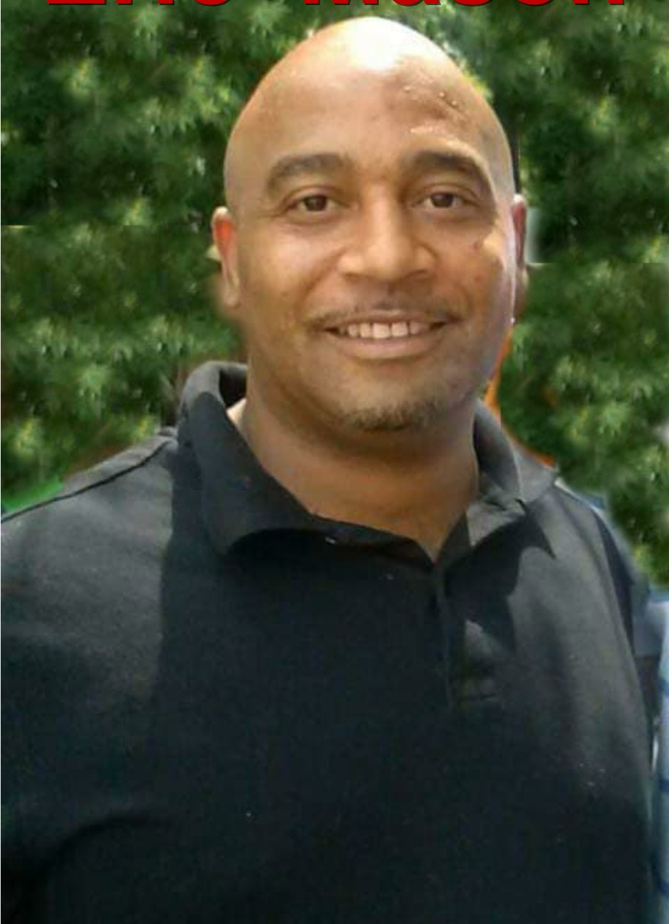
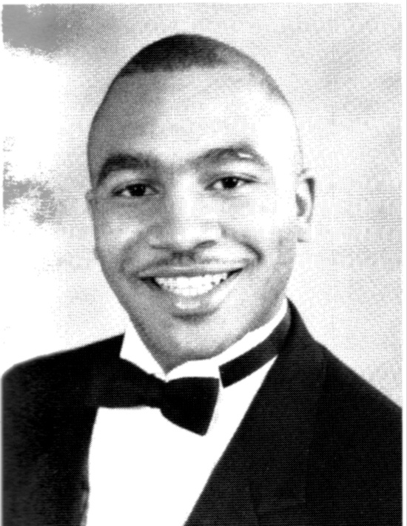
Eric Mason Class of ‘91

Slide 33
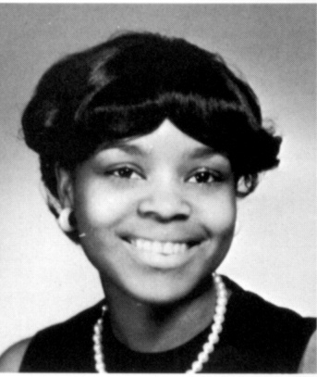
Francine Harper Class of ‘66

Slide 34
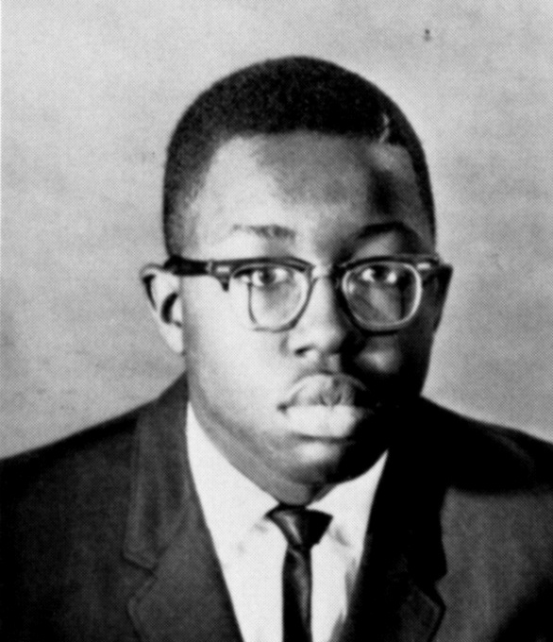
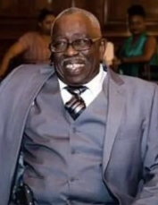
Francis Robinson Class of ‘65

Slide 35
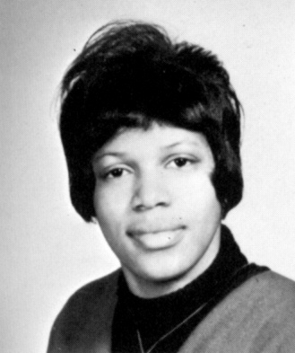
Gale Victoria America Harrison Class of ‘66

Slide 36
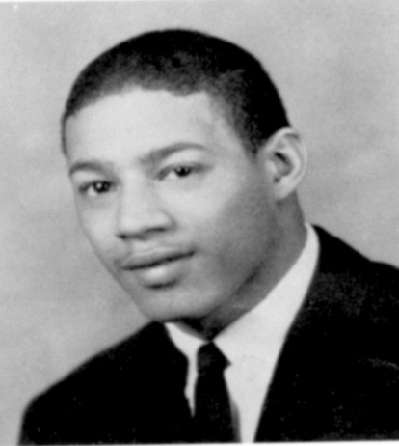
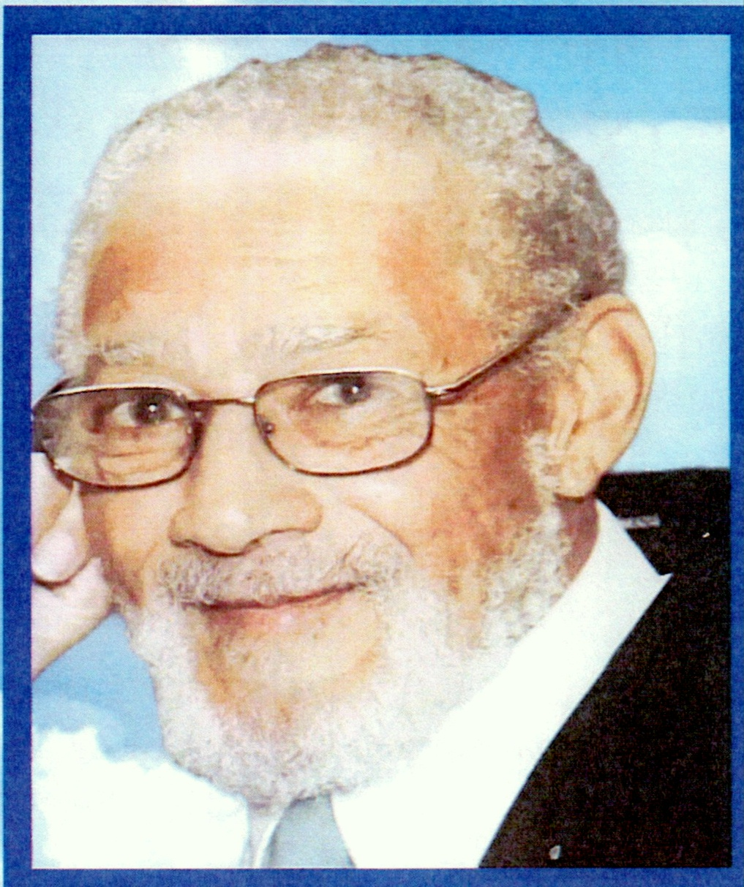
George E. Cook Class of ‘62

Slide 37
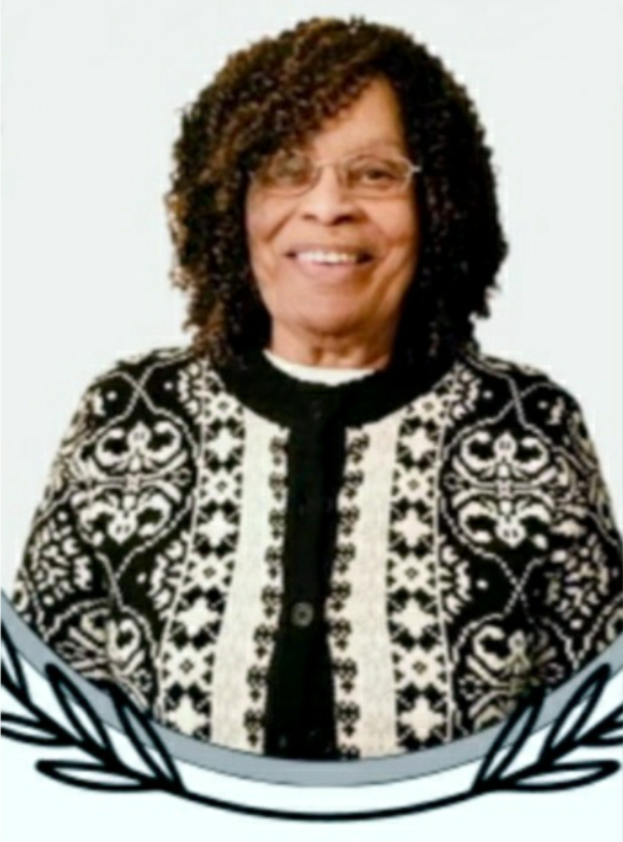
Helen Veronica Cole Class of ‘56

Slide 38
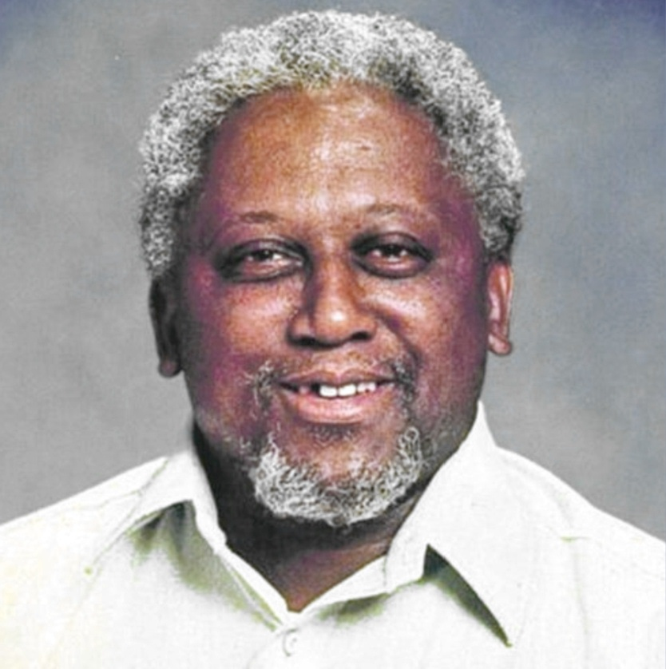
Herbert Leroy Johnson

Slide 39
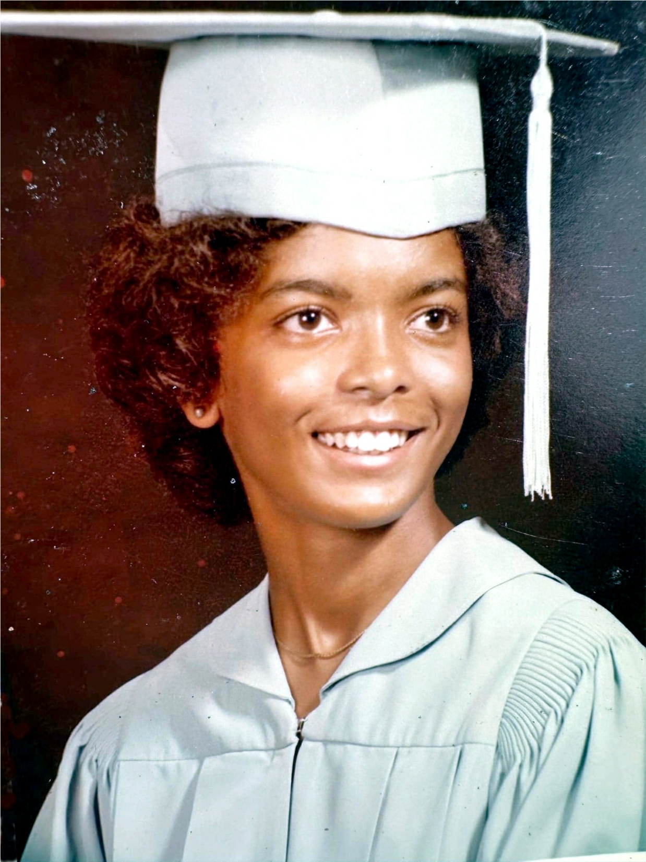
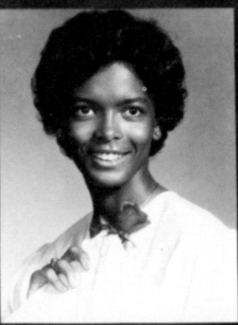
Jacqueline Brown Mitchell Class of ‘78

Slide 40
James Nichols Belt Class of ‘64

Slide 41
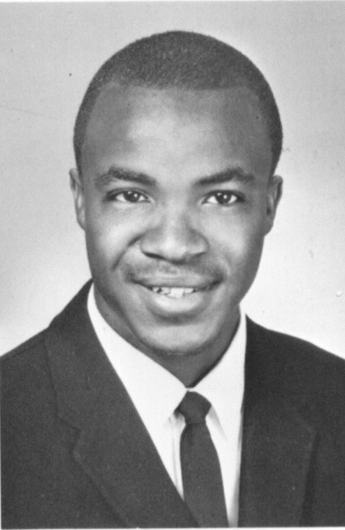
James Wesley Frayer Class of ‘68

Slide 42
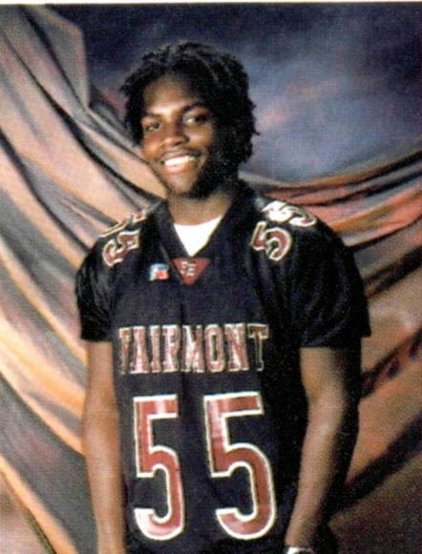
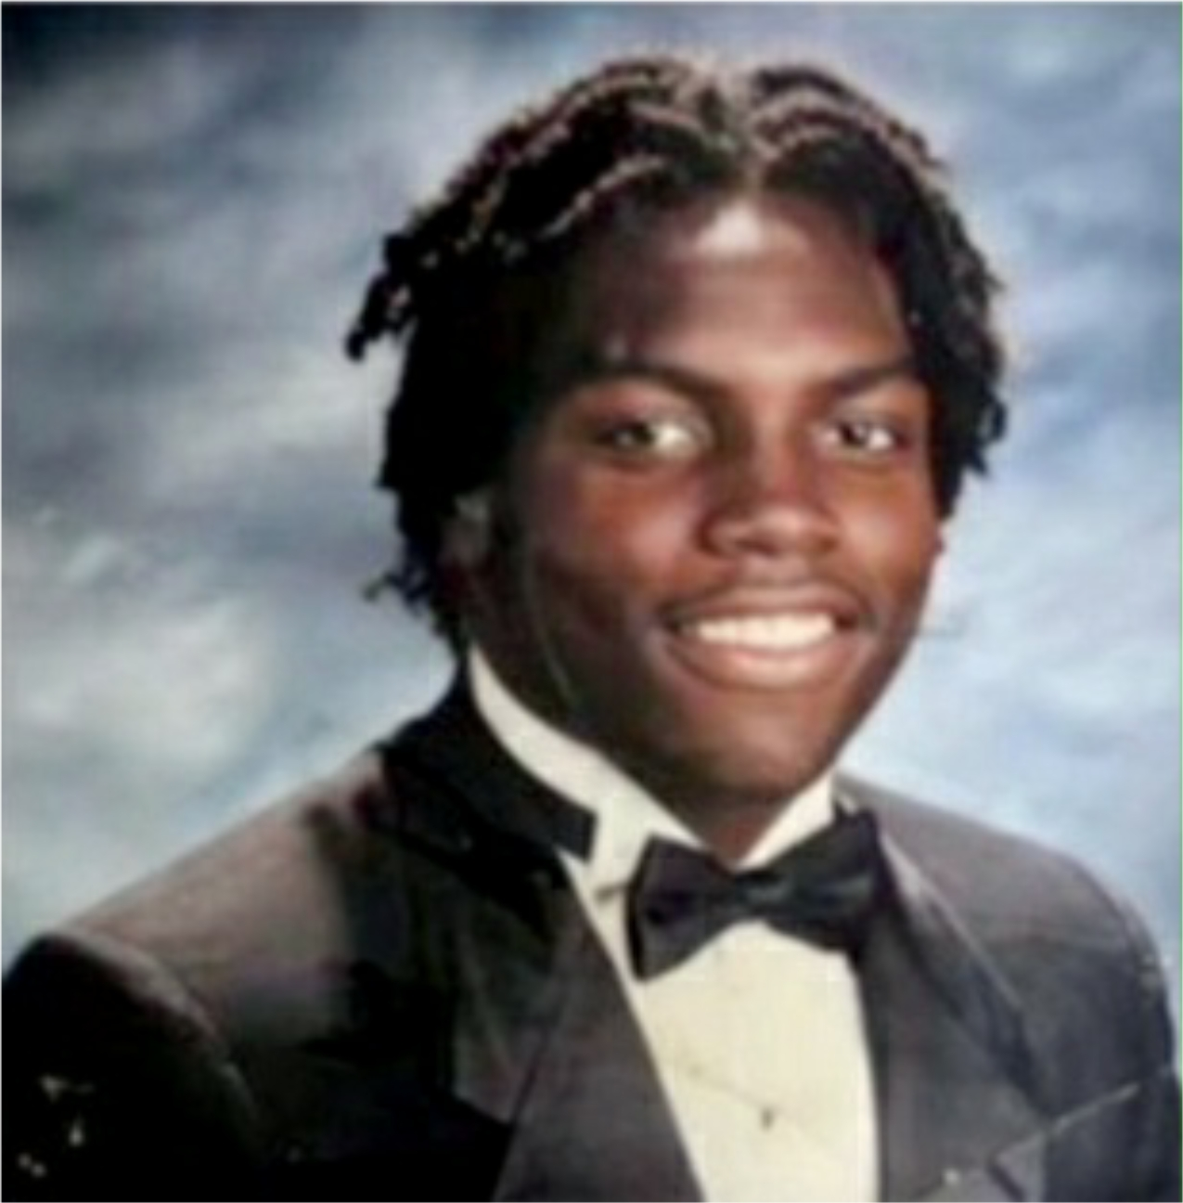
Jared R. Simmons Class of 2002

Slide 43
Jasmine Denise Snoddy Class of ‘98

Slide 44
Jean Fletcher Neal Class of ‘63

Slide 45
Jerry L. Edmonds Class of ‘72

Slide 46
Jimmie Lee Imes Class of ‘56

Slide 47
John Isiah Allen Class of ‘68

Slide 48
Joseph Freeman Franklin Class of ‘63

Slide 49
Jovette Hall Soloman Class of ‘71

Slide 50
Karen Sumter Class of ‘83

Slide 51
Kenon Johnson Class of 2000

Slide 52
Laverne Freeland Massie Class of ‘66

Slide 53
Larry Blackwell Class of ‘70

Slide 54
Lawrence E. Bennett Class of ‘87

Slide 55
Lynda Bradley Gravatt Class of ‘66

Slide 56
Marleen Tilghman Class of ‘60

Slide 57
Mary Ellen Wilkinson Ross Class of ‘60

Slide 58
Michael T. Sharp Class of ‘67

Slide 59
Mildred Wheeler-Gore Class of ‘64

Slide 60
Ninotchka Davis Porter Class of ‘59

Slide 61
Olivia Carter Class of ‘67

Slide 62
Philip Adams “Skippy” Class of ‘63

Slide 63
Raymond Dodd Class of ‘65

Slide 64
Robert Robinson Class of ‘69

Slide 65
Robert Wood

Slide 66
Ronny Clark Class of ‘62

Slide 67
Russell Frye Class of ‘74

Slide 68
Samuel Marshall Class of ‘60

Slide 69
Sandra Countee Bowman Class of ‘60

Slide 70
Sandra Cox Brown Class of ‘66

Slide 71
Sarah Pauline Gamble Class of ‘57

Slide 72
Sharon White Ellis Class of ‘69

Slide 73
Shirley Morgan Howard Class of ‘78

Slide 74
Stanley Maurice Allen Class of ‘60

Slide 75
Terrie Green Class of 2002

Slide 76
Timothy Dale Harvey Class of ‘83

Slide 77
Treny Mae Franklin Class of ‘68

Slide 78
Vernon Robinson Class of ‘63

Slide 79
Watson Harris Class of ‘70

Slide 80
William Isaac Edwards Class of ‘66

Slide 81
William Powell Class of ‘65

Slide 82
Yvonne Robertson Class of ‘83

Slide 83
All other HORNETS who “buzzed away” this year are included in this memorial service even though their names were not submitted.

Slide 84
HORNETS FOREVER

Slide 85
THANKS FOR THE MEMORIES

